Slide 1
EXCEL
Team: Dr. B.R Ambedkar

Slide 2
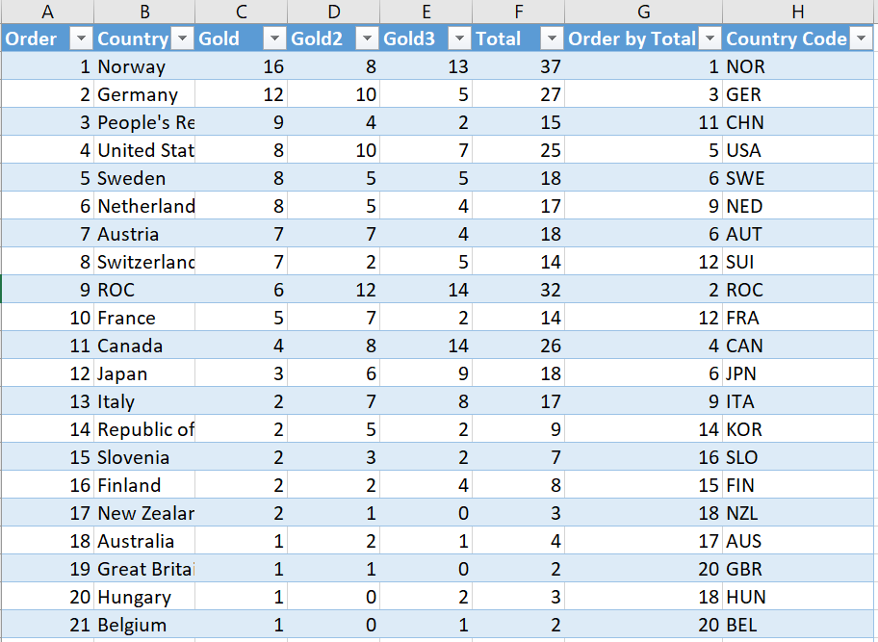
Beijing Winter Olympic Winners 2022
Table Format

Slide 3
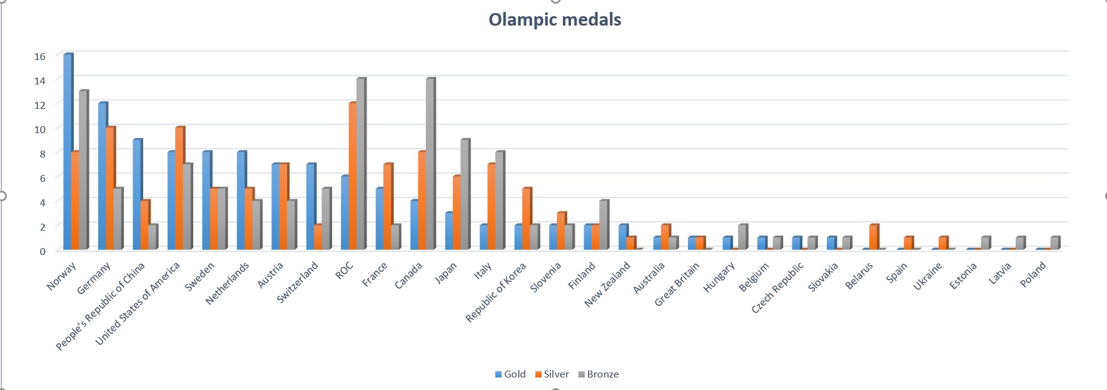
Olympic Medals won by countries

Slide 4
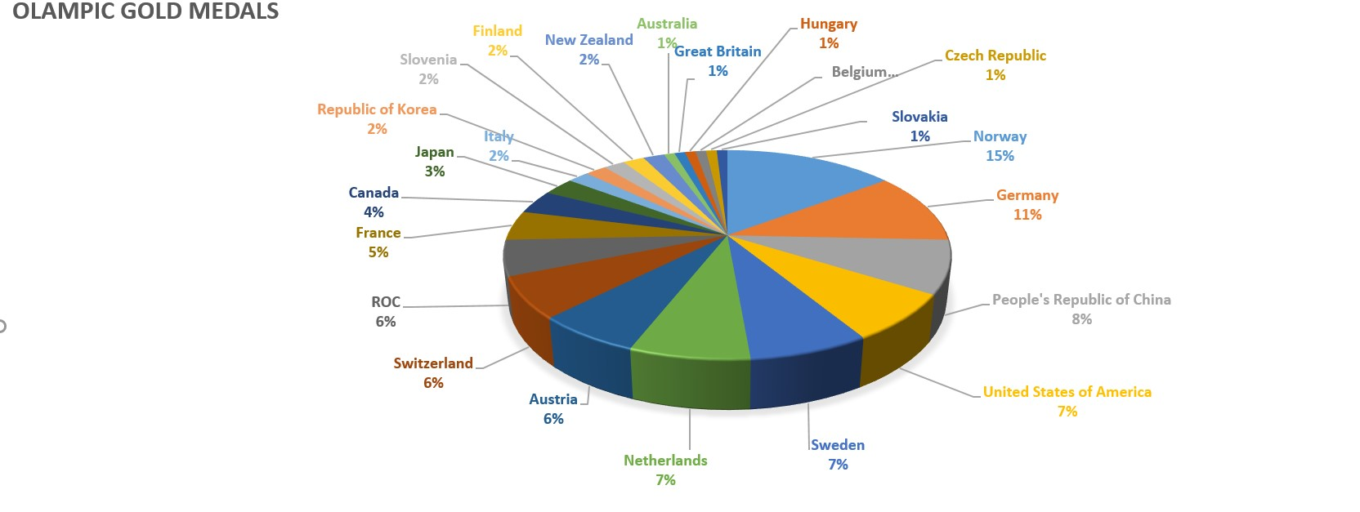
Gold medals won by countries in Percentage

Slide 5
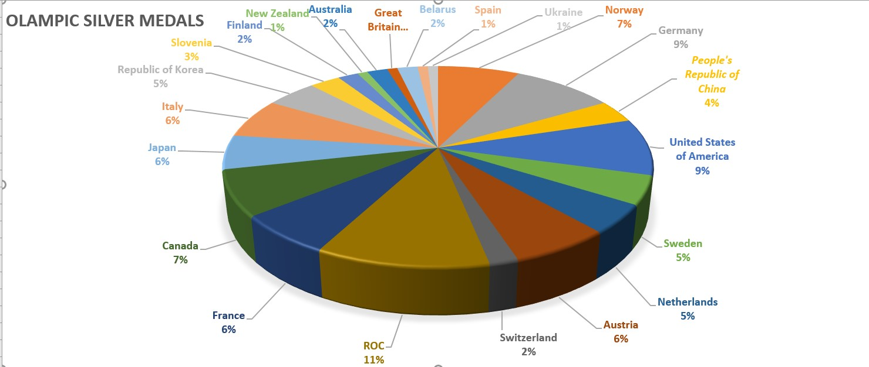
Silver medals won by countries in Percentage

Slide 6
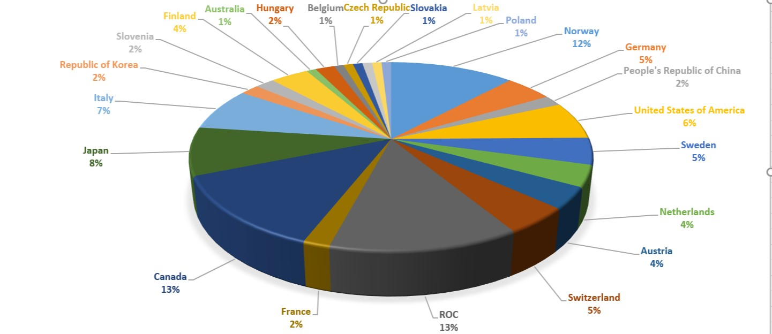
Bronze medals won by countries in Percentage

Slide 7
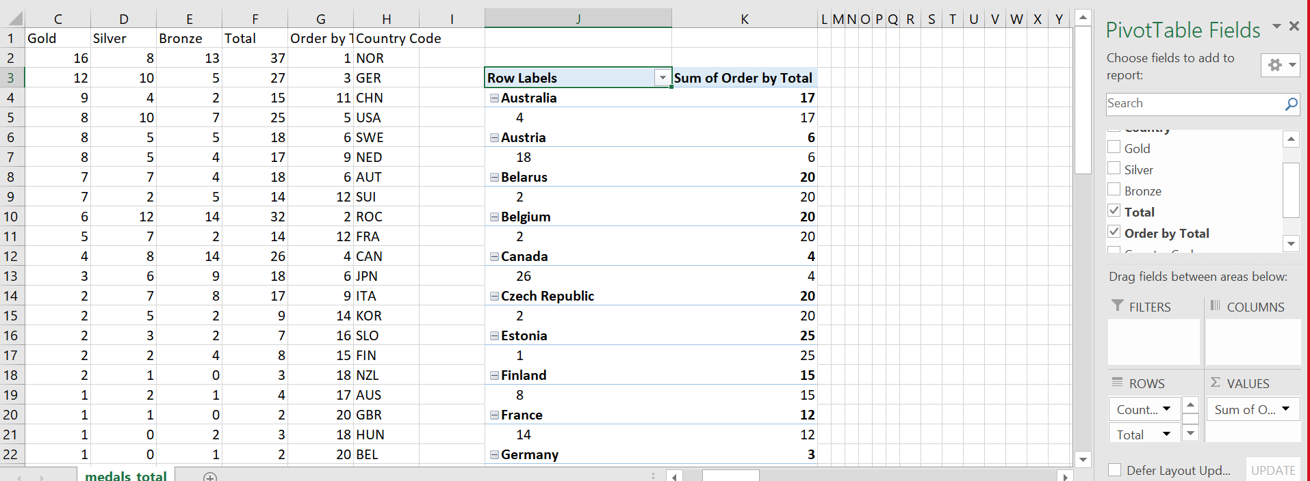

Pivoting the Data

Slide 8
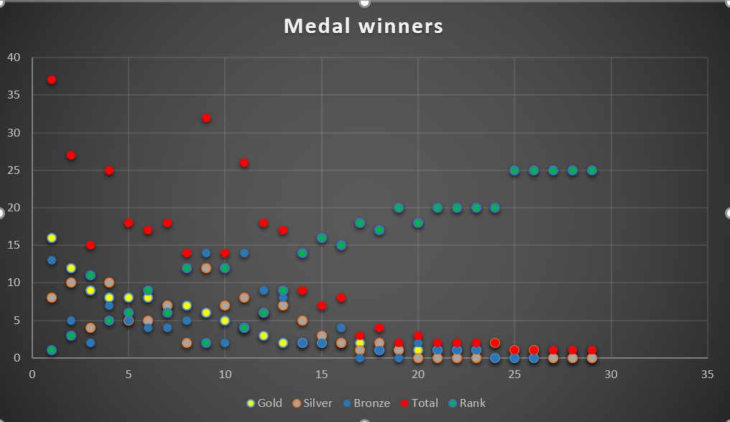
Graph representing winners of various medals

Slide 9
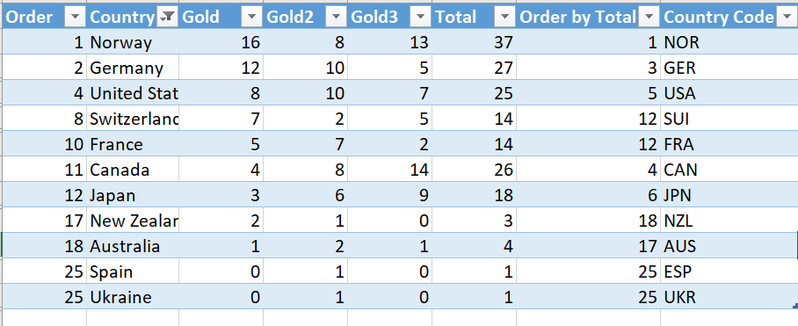
Filtering the Data

Slide 10
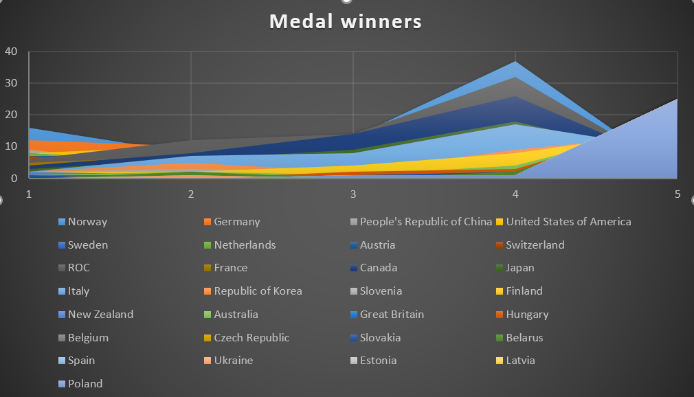
Medal winners of each country

Slide 11
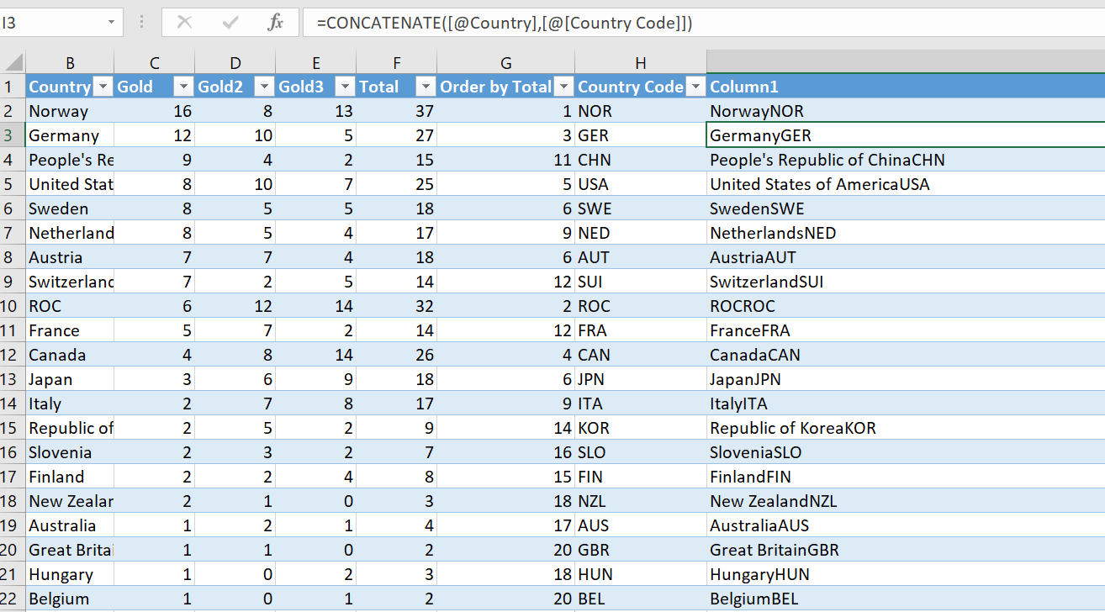
Concatenation of country and country code

Slide 12
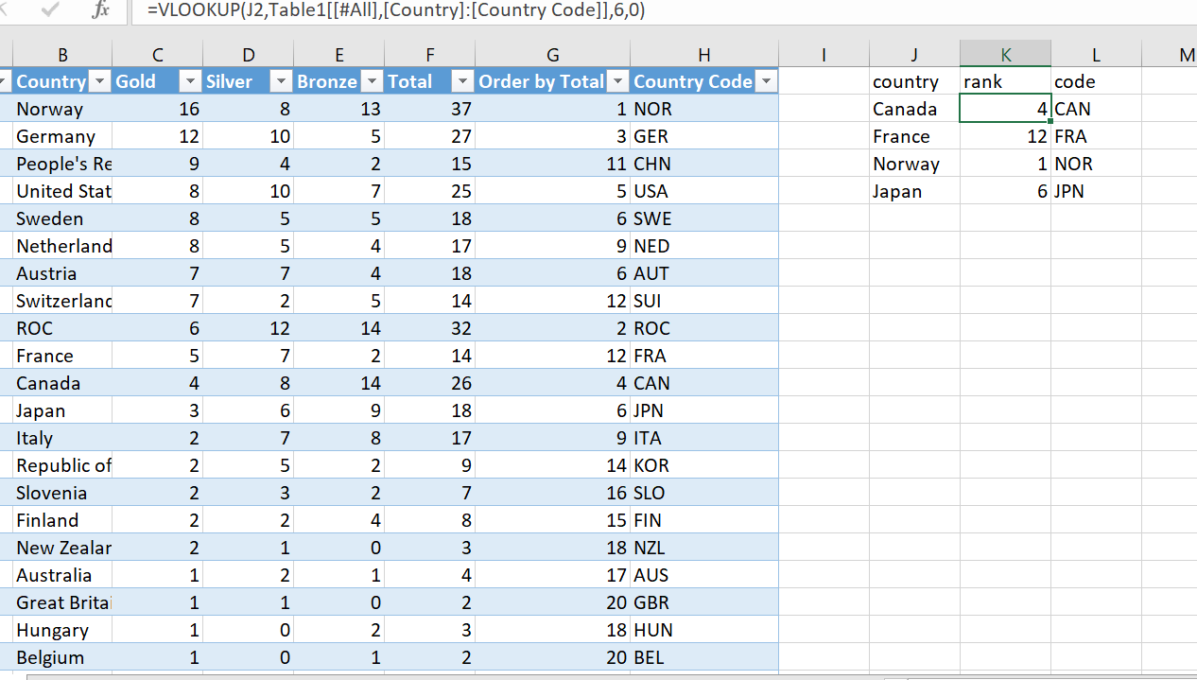
VLOOKUP of medals data set

Slide 13
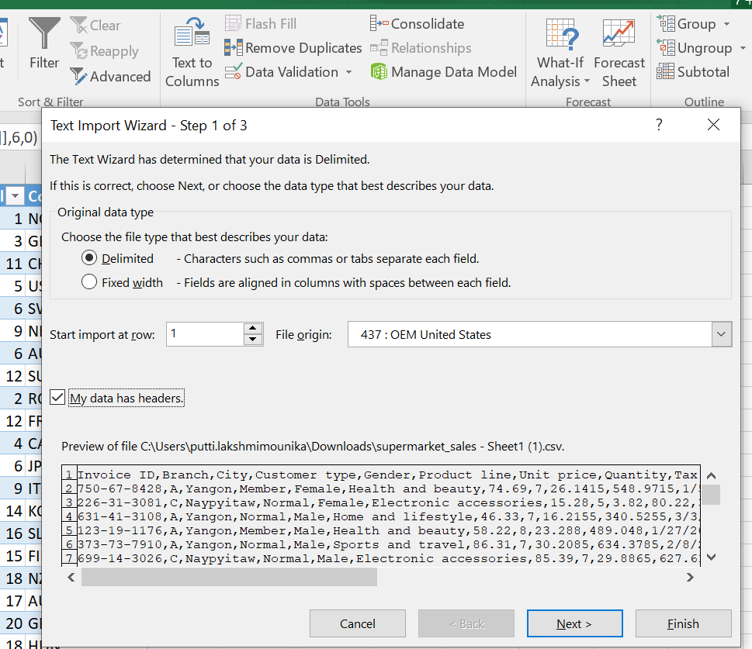
Importing data from external sources to Excel Step1:

Slide 14
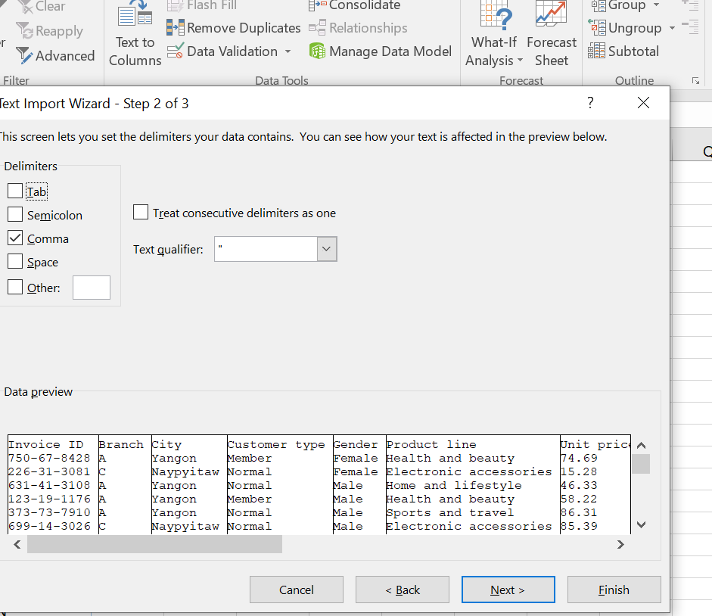
Step 2:

Slide 15
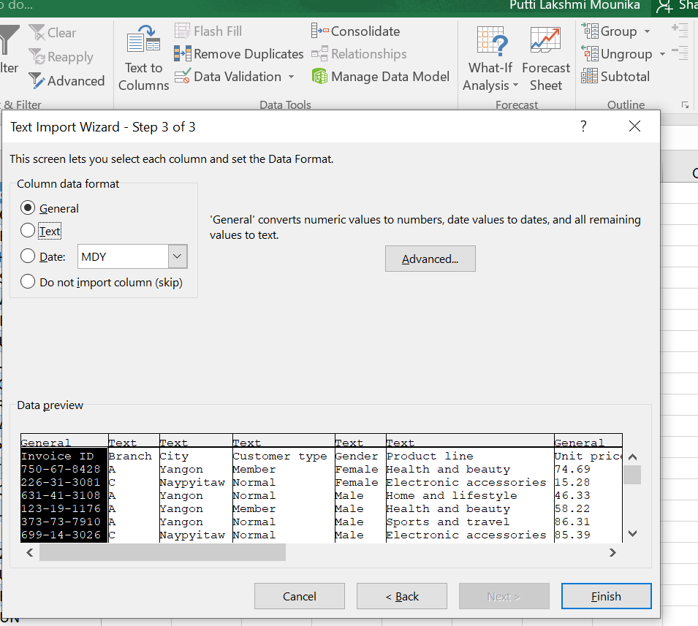
Step 3: Step 3:

Slide 16
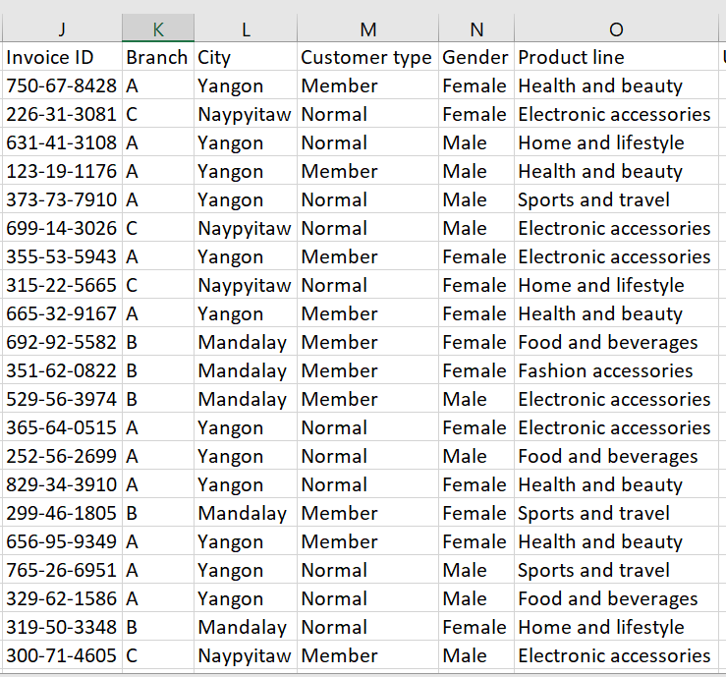
Viewing of data inserted from external sources

Slide 17
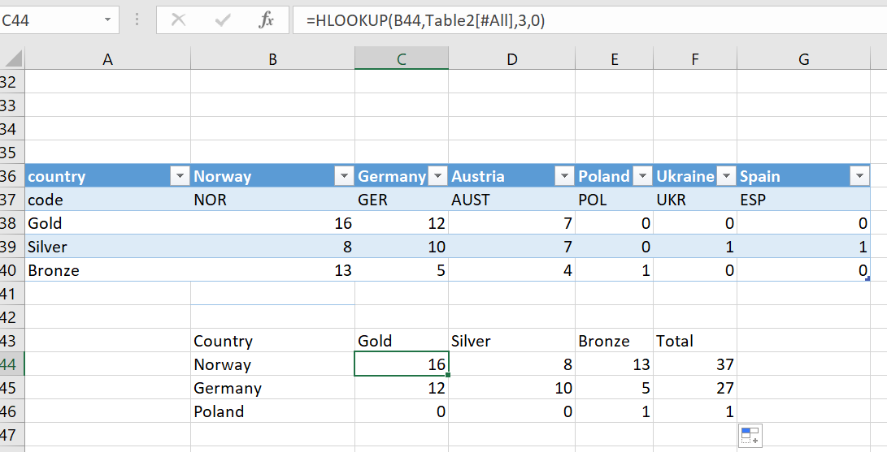
HLOOKUP of medal data set

Slide 18
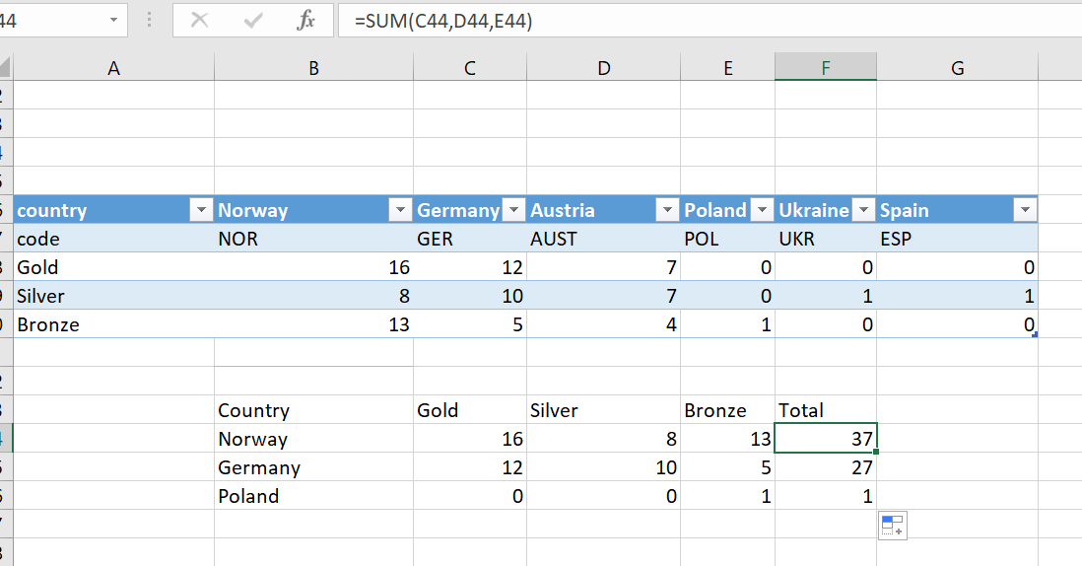
Using SUM function to get total number of medals won by each country

Slide 19
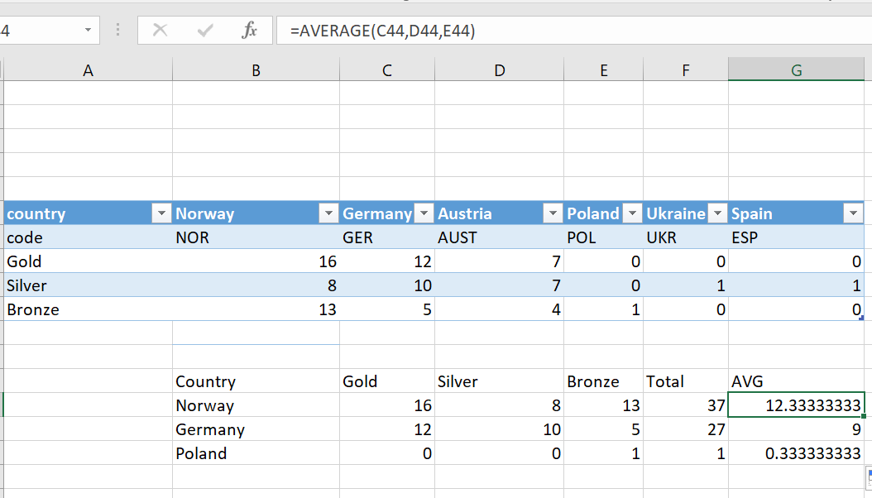
Calculating average medals won by each country

Slide 20

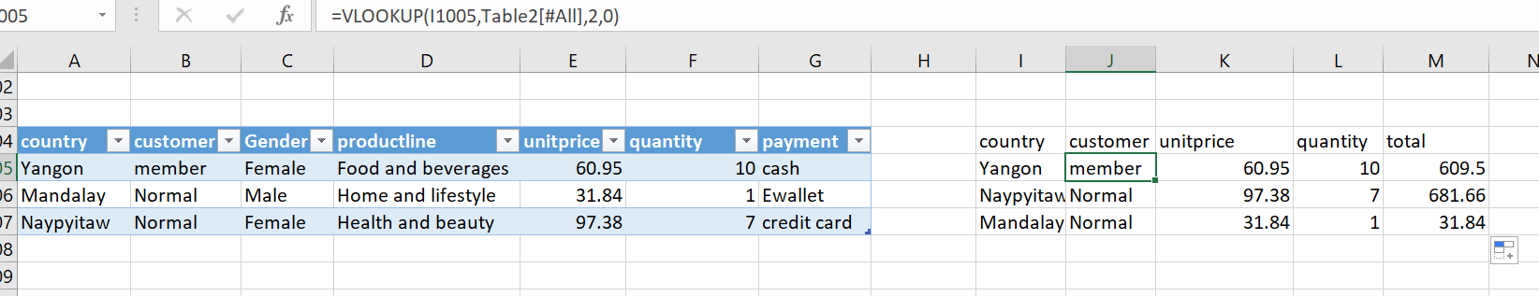
VLOOKUP of supermarket data set

Slide 21
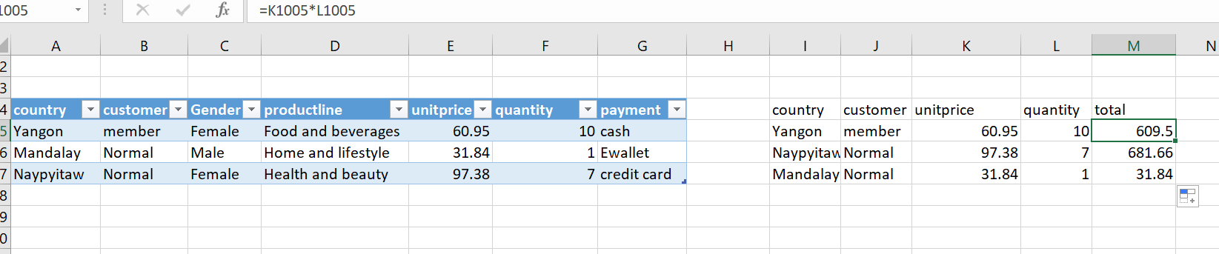
Multiplying unit price and quantity to get total amount

Slide 22
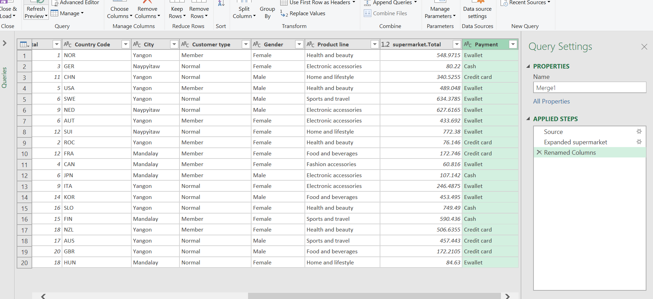
Inner join of supermarket sales and medals

Slide 23
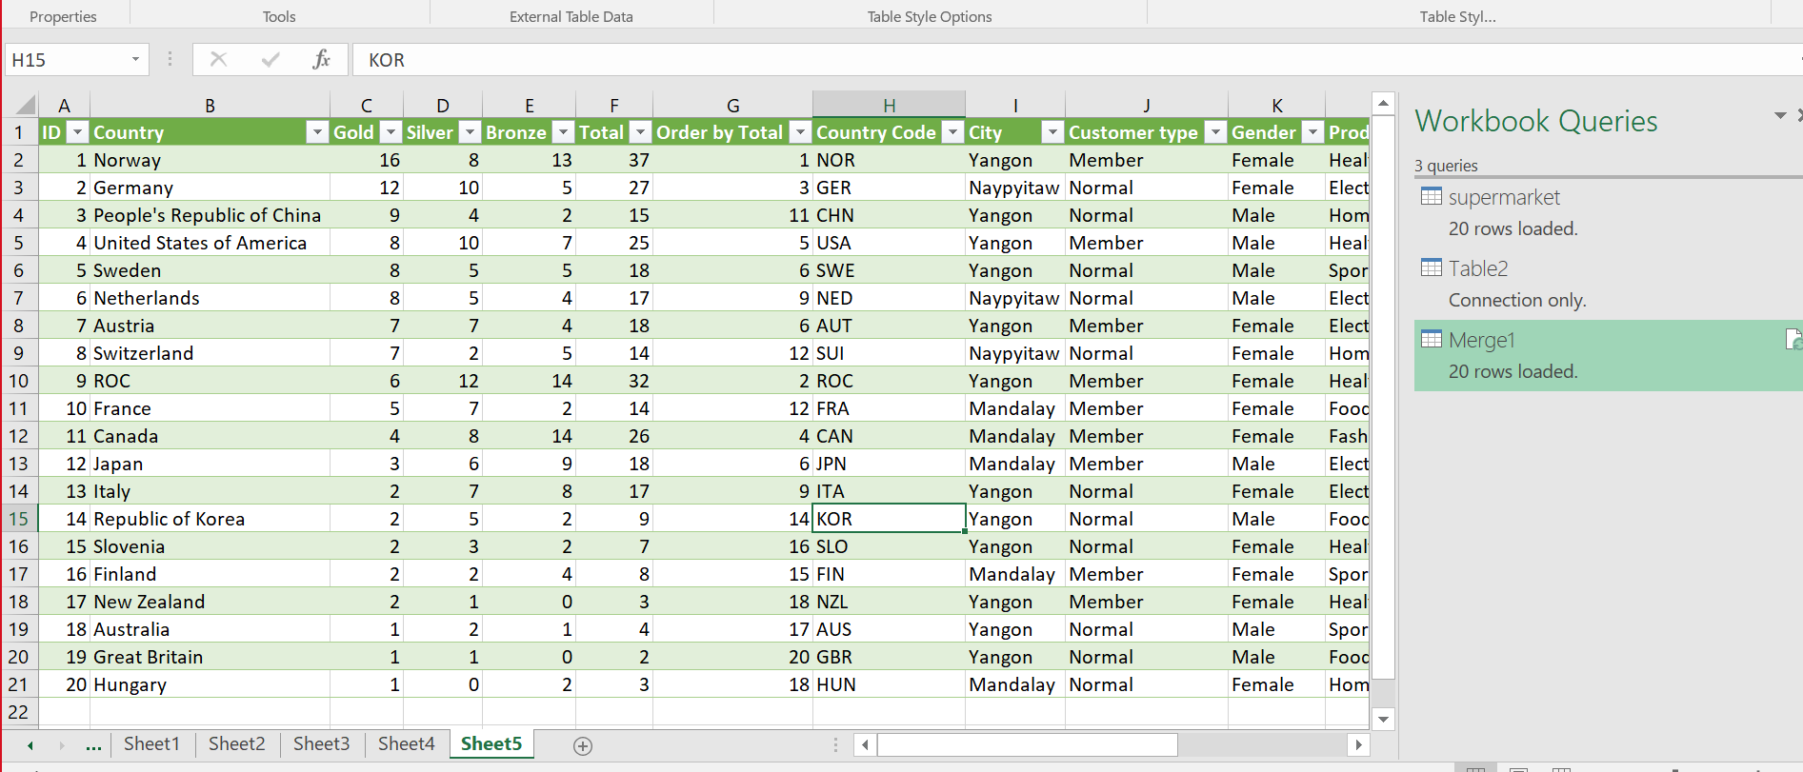
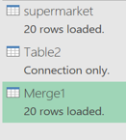
Loading the data into Excel sheet after inner joining the tables

Slide 24

THANK Y U
Kendre Ganesh
Kokkari Charanraj
Putti Lakshmi Mounika
Pamarthi Pavani
Harshitha Kuchimanchi

